Slide 1

High Level Technical Deck
2022 Update
OpenShift Product Management

Slide 2
Purpose of this presentation
Breaking down the ‘layered cake’
Technical detail for each ‘layer’
Links to roadmaps for ‘add on’ pieces
Notes:
map to the core components listed in the layer cake slide with then links for where to get more detailed roadmaps or technical details

Slide 3













Red Hat OpenShift
Multicluster management
Cluster security
Global registry
Observability | Discovery | Policy | Compliance | Configuration | Workloads
Declarative security | Container vulnerability management | Network segmentation | Threat detection and response
Image management | Security scanning | Geo-replication Mirroring | Image builds
Manage workloads
Build cloud-native apps
Data-driven insights
Developer productivity
Platform services
Application services*
Data services*
Developer services
• Service mesh | Serverless • Builds | CI/CD pipelines
• GitOps | Distributed Tracing
• Log management • Cost management
• Languages and runtimes
• API management
• Integration
• Messaging
• Process automation
• Databases | Cache • Data ingest and prep
• Data analytics | AI/ML • Data management & resilience
• Developer CLI | IDE
• Plugins and extensions • CodeReady workspaces • CodeReady containers
Kubernetes cluster services Install | Over-the-air updates | Networking | Ingress | Storage | Monitoring | Logging | Registry | Authorization | Containers | VMs | Operators | Helm
Kubernetes (orchestration)
Linux (container host operating system)
Physical
Virtual
Private cloud
Public cloud
Edge
* Red Hat OpenShift® includes supported runtimes for popular languages/frameworks/databases. Additional capabilities listed are from the Red Hat Application Services and Red Hat Data Services portfolios.
Notes:
Source: https://docs.google.com/presentation/d/1afUR89YbQulNUc12YCgdlsnZCRS23pTt3MPMMMwAZ3c/edit#slide=id.gd3332d7e4d_2_1078

Slide 4
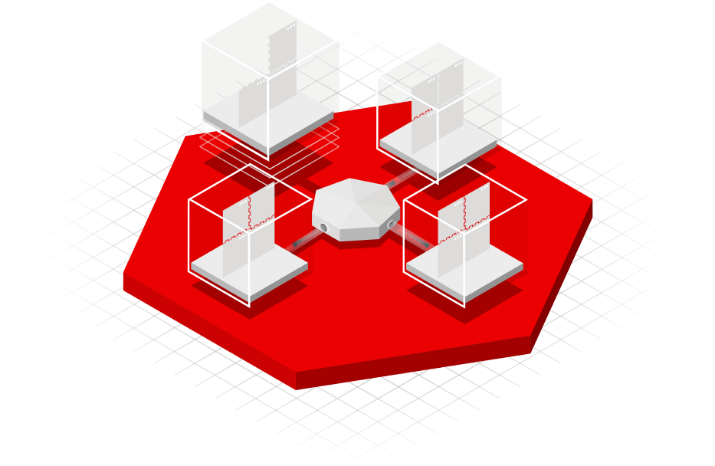
Linux & Kubernetes

Slide 5










Why Red Hat Enterprise Linux CoreOS?
Automatic updates
No interaction for administrators
Staying up to date → security fixes applied
Centrally configured infrastructure
Need a change? Update configs and re-provision.
User software runs in containers
Host updates are more reliable
An operating system for containers
Container based packaging
Kubernetes cluster based management
Delivered and updated with OpenShift
Industry standard RHEL security & compliance
Certified Red Hat Container ISV ecosystem
Linux (container host OS)
Physical
Virtual
Private cloud
Public cloud
Edge
Notes:
Link to latest RHCOS - https://docs.google.com/presentation/d/19j-kC2G0NScncWCcYn9_1d_k-3WklFupL_ka34O9jcs/edit#slide=id.gbda527d160_0_4603

Slide 6
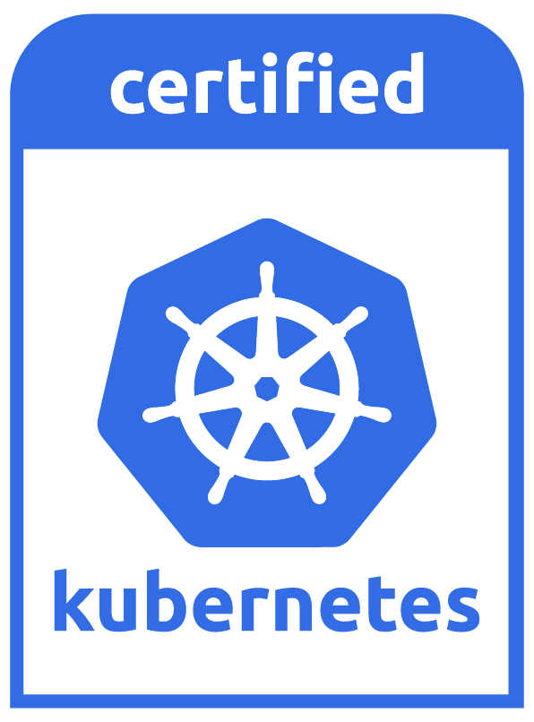
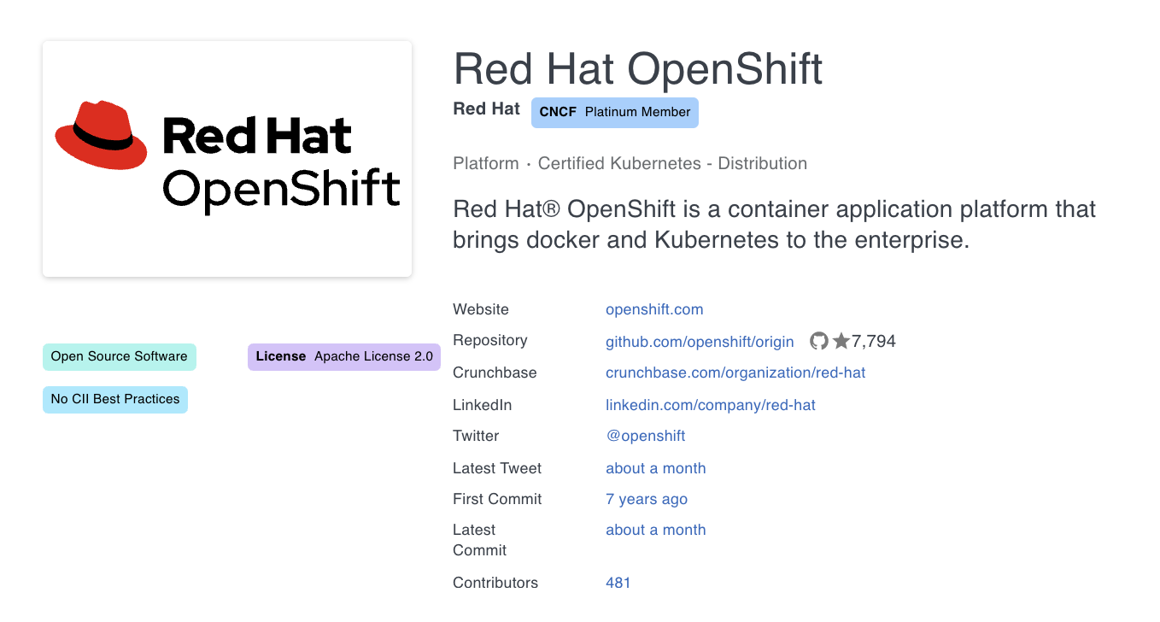
Kubernetes is the core of OpenShift
Kubernetes (orchestration)
Linux (container host OS)
Physical
Virtual
Private cloud
Public cloud
Edge
Notes:
OpenShift is Kubernetes at its core
100% CNCF Certified Kubernetes (OpenShift is both a CNCF Certified Distribution - OCP/OKE and Certified Hosted Service - OSD/ARO/ROSA)
Red Hat’s first commit to Kubernetes was 7 years ago (early 2014) - more than 4 months before the Kubernetes project was publicly launched
Red Hat partnered with Google on that launch and combined with Google have driven the majority of Kubernetes contributions since inception
To date, nearly 500 Red Hatters have contributed to the Kubernetes project

Slide 7
Kubernetes Cluster Services

Slide 8












Kubernetes Cluster Services -
OpenShift enables enterprise ready containers
Fully automated OpenShift installer provisioned infrastructure
Prometheus monitoring and alerts for to manage your clusters
Immutable over the air or air gapped updates with telemetry
Log collection & forwarding to external log management systems
Integrated OpenShift SDN (OVS/OVN), ingress & CNI plugins
Built in OpenShift Registry to securely manage container images
Kubernetes native storage (Ceph/Rook) & certified CSI plugins
Integrated authentication, authorization & deployment policies
Deploy and manage both Containers & VMs (Kubevirt)
Leverage Kubernetes Operators & Helm Charts to manage deployments
Kubernetes Cluster services Install ⠇Over-the-air updates ⠇Networking ⠇Ingress ⠇Storage ⠇Monitoring ⠇Logging ⠇Registry ⠇Authorization
Containers ⠇VMs ⠇Operators ⠇Helm Charts
Kubernetes (orchestration)
Linux (container host OS)
Physical
Virtual
Private cloud
Public cloud
Edge

Slide 9










Fully automated or customized OpenShift installer provisioned infrastructure
Simplifying and automating the installation process
 | Full Stack Automation | Pre-existing Infrastructure
Build Network | Installer | User
Setup Load Balancers | Installer | User
Configure DNS | Installer | User
Hardware/VM Provisioning | Installer | User
OS Installation | Installer | User
Generate Ignition Configs | Installer | Installer
OS Support | Installer: RHEL CoreOS User: RHEL Workers (on Day 2) | User: RHEL CoreOS User: RHEL Workers (on Day 2)
Node Provisioning / Autoscaling | Yes | Only for providers with OpenShift Machine API support
Customization & Provider Support | Best Practices: AWS, Azure, GCP, RHOSP, RHV, & vSphere | Yes: AWS, Azure, GCP, Bare Metal, RHOSP, & vSphere
Full Stack Automation (IPI)
Bare Metal
Pre-existing Infrastructure (UPI)
Azure Stack Hub
Bare Metal
IBM Power Systems
Notes:
https://docs.google.com/presentation/d/12jHC4SbDqnTsmPbgNrTzDz9jQSnctwMAE8Of8UznjwY/edit#slide=id.g8a6bf02f47_8_74
https://docs.google.com/presentation/d/1rKTx__DqpVv5ZkFV_f8VjLuhwWozKeM5jIyJ5WgqKj0/edit#slide=id.gc08fb34342_0_4
Since our customers want to deploy OpenShift into many different clouds and environments, we have introduced IPI and UPI or in other words…. Installer-Provisioned-Infrastructure and User-Provisioned-Infrastructure.
IPI provides you with a simplified and opinionated “best practice” installation.
This means that everything is installed and configured for you providing the best & fastest experience.
We have customers who incorporate the IPI installation method into their CICD process so that they can spin up whole clusters, automatically install and test their applications and shut it all down again!
UPI (or User-Provisioned-Infrastructure) is a way to install openshift into your existing infrastructure. This is needed for the times when you do need full control.
OpenShift 4 is now not only much easier to install but also easier to patch and upgrade.
All this helps our customers deploy their applications even faster into production.
Take a look at all the platforms that are supported … there are some new additions that I want to highlight: for example… we now support a fully automated installation on VMware vSphere … and full IPI support for bare-metal in OCP4.6. Yes, once you’ve plugged your physical machine into the network and powered it on, it can be automatically provisioned with OpenShift or added into an existing OpenShift cluster.

Slide 10
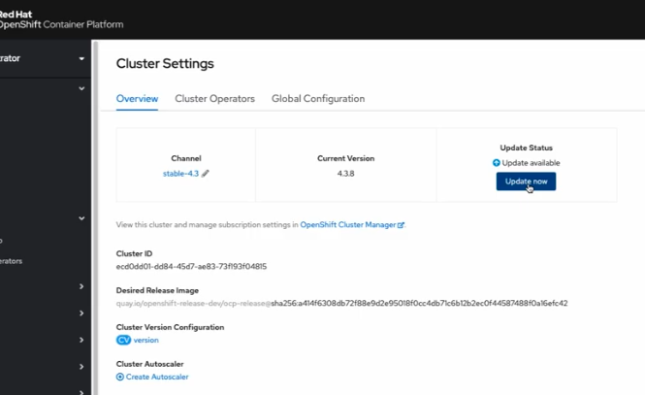
OpenShift “Over-The-Air” Cluster Updates
Over the air or air gapped updates with telemetry
Intelligent OpenShift cluster updates - automated via the Operator paradigm
Single update mechanism for the operating system and container platform
Patches/updates available weekly
Keep systems updated with the latest patches and features
No waiting - access to updates when you need them
Saves administrators significant time on cluster updates
Notes:
https://docs.google.com/presentation/d/12jHC4SbDqnTsmPbgNrTzDz9jQSnctwMAE8Of8UznjwY/edit#slide=id.g8a6bf02f47_1_119
https://access.redhat.com/labs/ocpupgradegraph/update_path

Slide 11







Integrated OpenShift SDN (OVS/OVN), ingress & CNI plugins
Unified traffic handling so you configure all your traffic the same way
Gateway API
Internet
Any supported platform – add or swap easily, hybrid scenarios
Managed cloud
Private cloud
Public cloud
Physical
Virtual
Edge
Upcoming
Platform-Native Load Balancing
Flexibility to use native traffic distribution for optimal performance
Ingress Controller
Your traffic, your way: L4-L7, Envoy, by-pass
OVN for advanced traffic workloads
IPv6 single/dual for scale
HW Offload (OVS, IPsec, ...) for performance
Multi-NIC support to align host networking
BGP-advertised services (FRR)
Observability for improved understanding
eBPF precision traffic control
No-overlay option
OVN
Pod
Pod
OVS
Pod
Node
Node
Node
Notes:
https://docs.google.com/presentation/d/1Fgw0W6KnY_ebU3d7zYmCD8OobFDqlzZto2onhqX5RLw/edit#slide=id.g84bc04ca26_0_1275
OpenShift today has more than one way to ingress traffic to the cluster. Customers can choose Routes or Kubernetes Ingress, two different technologies with different feature sets.
Starting with a Technical Preview in 4.8, we hope to begin the process of unifying ingress for OpenShift starting with Gateway API. Gateway API has undergone several name changes, so you will see it also listed as “Ingress v2” and “Services API”. Gateway API, its permanent new name, is a set of APIs for deploying L4/L7 routing in Kubernetes, that is expressive (core functionality for things like header-based matching and traffic weighting, instead of customizations of routes/ingress), improved extensibility of hte API, and role-oriented (different API resources that map to common k8s application development roles).
MetalLB - https://issues.redhat.com/browse/ART-3029
https://docs.google.com/presentation/d/1lLhhVeZ1wKdfKBd0e4CukekHD-izaM_Q-F0-famIb7M/edit#slide=id.ge3cda3f16f_0_941
Contour - https://issues.redhat.com/browse/ART-3135

Slide 12


OpenShift SDN
External Networks
Nodes Network
Nodes
NAT
NAT
Nodes
OpenShift SDN
OpenShift SDN
ovsdb
ovsdb
Open vSwitch (br0)
Open vSwitch (br0)
Port B
tun0
VxLAN tunnel(s)
tun0
Port B
Port A
vxlan0
vxlan0
Port A
Port x
Port y
Port z
Port x
Port y
Port z
Notes:
https://docs.google.com/presentation/d/1jkY-vBAxOU3ot7WFnbu7x0Y5cG-Px5ORWW9CKGhmaLY/edit#slide=id.g4771503045_0_2771

Slide 13


OVN Kubernetes (logical)
Cluster Logical Switch
Nodes
Nodes
Cluster Logical Router
Gateway
Router
Gateway
Router
Node Logical Switch
Node Logical Switch
Gateway
Switch
Gateway
Switch
Port x
Port y
Mgmt
Mgmt
Port x
Port y
Host to OVN
Host to OVN
NIC
NIC
br-nexthop
GENEVE
GENEVE Tunnels
GENEVE
br-nexthop
OVN to External
OVN to External
Nodes Network
External Networks
Notes:
https://docs.google.com/presentation/d/16XYCkEPBqNsmKJGmi6WfFndFsyNg-VeAZKUPFgoyDXw/edit#slide=id.p22
Management port is where packets destined to cluster network (overlay) goes into from the host
OCP SDN tun0 equivalent is split between "k8s-<node name>" and br-nexthop
OVS creates a flow-based kernel VXLAN interface (vxlan_sys_4789) and the kernel moves traffic to that "foo over UDP" interface and then ends up into the OVS bridge
OVN uses GENEVE for east-west traffic
GENEVE in Linux and OVS uses normal kernel GENEVE tunnel interfaces
br-nexthop is for pod -> cluster external
k8s-<node name> = host -> pod

Slide 14
OpenShift Networking Plug-ins
OPENSHIFT
KUBERNETES CNI
OpenShift SDN
OVN
Tigera Calico (open src)
Cisco ACI
VMware NCP
Isovalent
Cilium
VMware Antrea
Juniper Contrail
kuryr-
kubernetes²
DEFAULT
4.x
4.6+
4.2+
4.4+
4.4+
4.5+
4.6
Q3CY2021
4.2.2+
Certified plugins are a jointly supported effort between Red Hat and the partner
Certification process includes tests to validate compatibility and ensure customer success
Use certified plugins with confidence that they will deliver functionality with OpenShift
Specific compatibility matrixes are maintained by the partners
RH-OSP
Neutron
Plugin
Fully Supported
Tech Preview
Cert In-Progress
Notes:
The list of Red Hat GA’d CNI plugins is here: https://access.redhat.com/articles/4763741
The public-facing list of third-party certified CNI plugins is here: https://access.redhat.com/articles/5436171
Juniper Contrail / Red Hat sync - https://docs.google.com/document/d/1ecogUzDGVBqb-pyIFSML0yf4F9-eKC42bo4ZI4uSQBc/edit

Slide 15

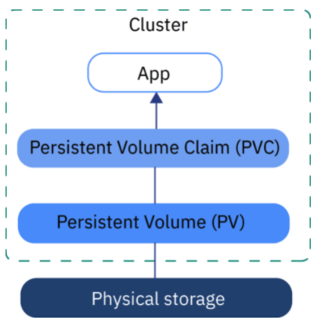
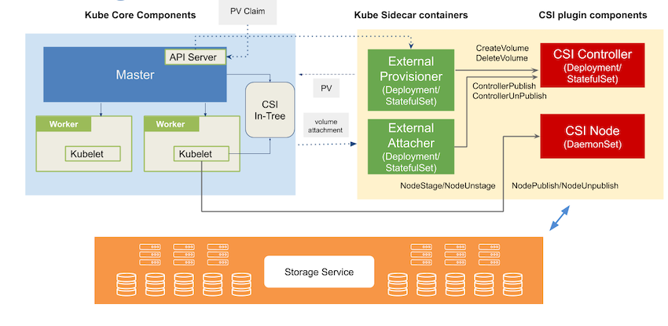
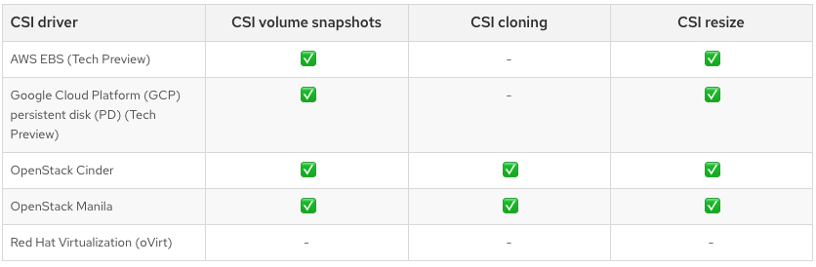
Kubernetes native storage & certified CSI plugins
Persistent Storage
RWO - ReadWriteOnce
ROX - ReadOnlyMany
RWX - ReadWriteMany
Container Storage Interface
 | RWO | ROX | RWX
AWS Elastic Block | X
Azure Disk | X
Azure File | X | X | X
Cinder | X
Fibre Channel | X | X
GCE Persistent | X
hostPath | X
iSCSI | X | X
Local volumes | X
NFS | X | X | X
ODF | X
VmWare vSphere | X
OpenStack Manila |  |  | X
we test and support the in-tree and select CSI provisioners, partners fill in the gaps for their storage, and we'll be (hopefully) seamlessly transitioning customers to CSI as in-tree drivers are removed.

Slide 16

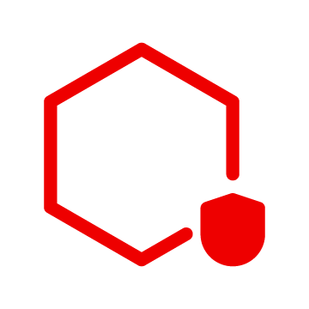




Including Windows Containers in OpenShift
Deploy and manage both Containers & VMs
KVM
virtual machine
Windows
virtual machine
Linux containers
Windows containers
Windows containers
Linux containers
Windows application
Linux containers
.NET core
containers
Windows traditional .NET framework containers
Windows traditional .NET framework containers
.NET core containers
.NET core containers
Red Hat OpenShift Virtualization
Red Hat Enterprise Linux CoreOS
Red Hat OpenShift Virtualization
Red Hat Enterprise Linux CoreOS
Red Hat Enterprise Linux CoreOS
Microsoft Windows
Microsoft Windows
Machine API Managed Infrastructure
BYOH instance
Red Hat OpenShift runs management and scheduling of:
Linux containers on Red Hat Enterprise Linux CoreOS
.NET core containers on Red Hat Enterprise Linux CoreOS or Windows
Traditional .NET framework containers on Windows
Windows virtual machines with OpenShift Virtualization
Bring your own Windows Hosts
Reuse "pet" Windows instances as OpenShift worker nodes, run Windows workloads and gain similar benefits that their Linux workloads get when being managed by OpenShift
Notes:
https://docs.google.com/presentation/d/1g8PE8B6Ltdv4Bu6VH6je0njuE1JNH1gAf_tDPthjPWw/edit#slide=id.g6f182ec62b_0_0
https://docs.google.com/presentation/d/1KKjXcxaqUD_2JBnAjwkEv1po2VFGkMgoqHNcyMYBGjs/edit?ts=6037d7b3#slide=id.gbd5f5dd598_3_358
In the future, Windows Containers for Red Hat OpenShift will be available on more number of platforms including private and public cloud, and edge deployments.
The installation experience for these platforms will be facilitated with a Bring Your Own Host “BYOH” model. The world of Windows sees customers treating their instances more as "pets" rather than "cattle". There is a desire from customers to be able to reuse these "pet" Windows instances as OpenShift worker nodes, run Windows workloads and gain similar benefits that their Linux workloads get when being managed by OpenShift.

Slide 17





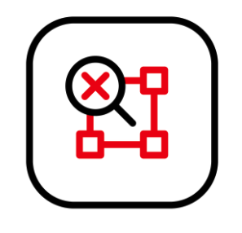
Log collection & Observability
Observability
Advanced Cluster Management
Multi
Cluster
OpenShift Console
OpenShift Monitoring
OpenShift Logging
OpenShift Tracing
Single
Cluster
Out of the box monitoring
Extend to your own needs
Collect & forward
Low retention storage
Notes:
https://docs.google.com/presentation/d/1pqvGeZCHExFQksTXwBV0o7r2cK-RJPky_wCjPHvJqZM/edit#slide=id.g6b619a1e04_0_2548
Need additional detail on Tracing...when available
https://docs.google.com/presentation/d/1cIPOp7pAVJXxFq4JlC1K2gkUy-3L3i4drHuE890OqM0/edit#slide=id.ge1d6f51160_0_4563

Slide 18

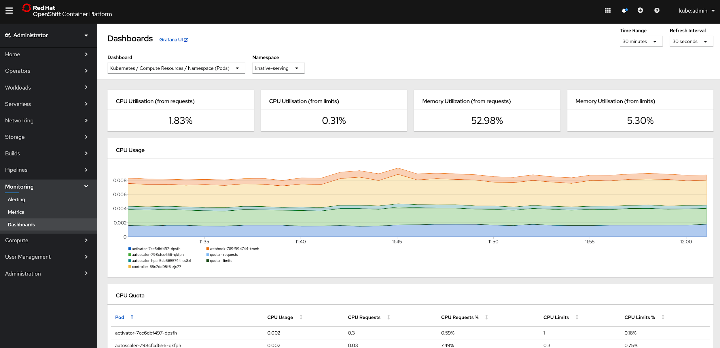


Prometheus monitoring and alerts for to manage your clusters, infrastructure and workloads
Low level infrastructure
Top level workload
Kubernetes
Middleware
All user workload running on OpenShift exposing metrics can easily integrate those into the OpenShift Monitoring framework.
Hosts
Service Mesh
OpenShift
User Workload
All underlying infrastructure exposing metrics can easily integrate those into the OpenShift Monitoring framework.
VMs/Virtualization
Information is bubbled up into the console for further troubleshooting.
Anything really
Customize monitoring
Network
Cloud Environments
Metrics collection and storage via Prometheus, an open-source monitoring system time series database.
OpenShift
Monitoring
APIs
OpenStack
APIs
Alerting/notification via Prometheus’ Alertmanager, an open-source tool that handles alerts send by Prometheus.
Framework
Metrics visualization
via OpenShift Console and Grafana.
Notes:
https://docs.google.com/presentation/d/1akCG5jPFzrckMwDm_j4KjHsdwGTMZHaLFn7FikXL-g4/edit#slide=id.g5ee005cb1d_0_0
https://docs.google.com/presentation/d/1jGZKju1Kyb6eaU6g_GLcZ3_AstkmedEvpSuTThvUJUk/edit#slide=id.g718e694e43_1_0

Slide 19
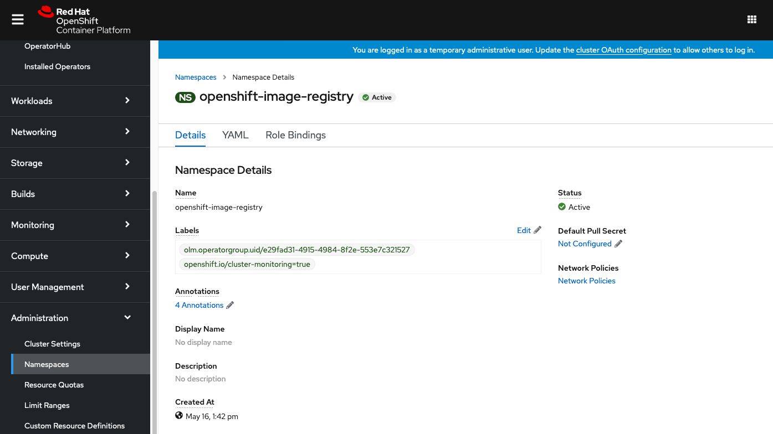
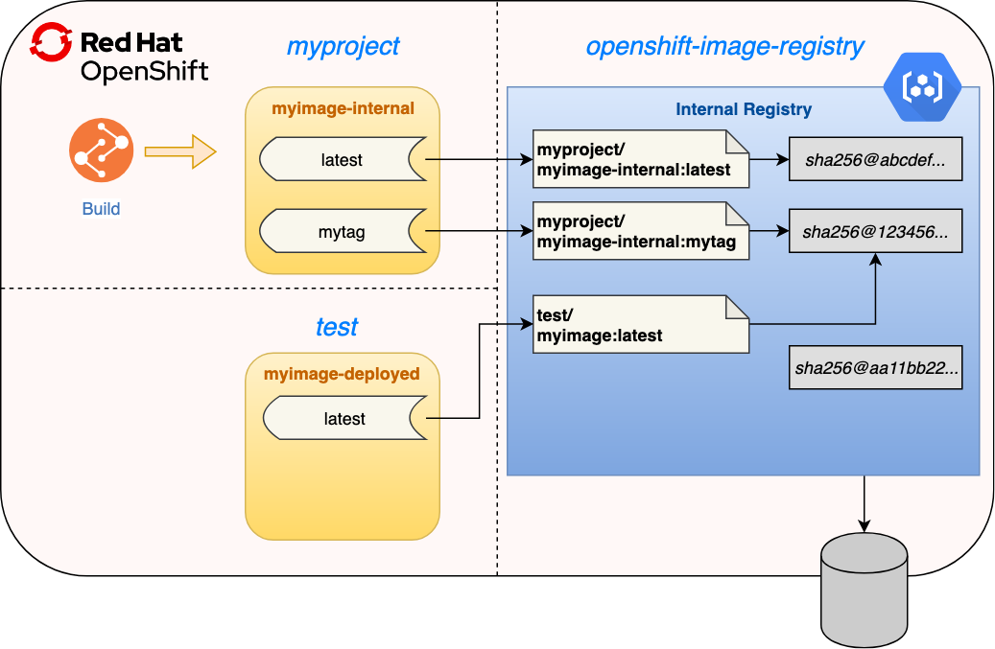
Built in OpenShift Registry to securely manage container images
OpenShift provides a built-in container image registry managed by an infrastructure operator. The registry is typically used as a publication target for images built on the cluster, as well as being a source of images for workloads running on the cluster… for a more enterprise grade registry… i.e. Quay go here
Notes:
https://docs.google.com/presentation/d/15lKaAmWRj1PxhM-k1J0E-MPv9m7BTr-2JP2e04Y4YrA/edit#slide=id.g80c0345f91_0_0

Slide 20
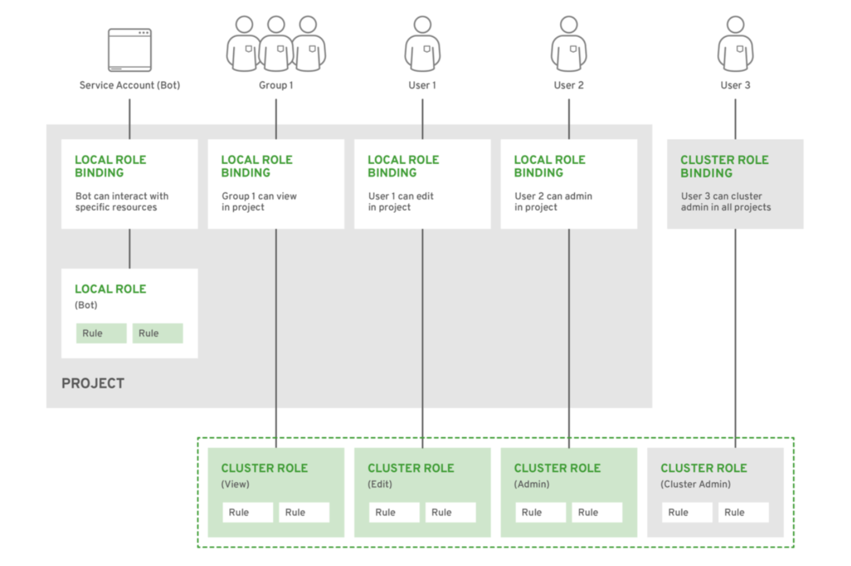
Integrated authentication, authorization & deployment policies
Authentication
Restrict user access through trusted identity providers
Integrate with platform OAuth server to
Connect to external identity provider -- 9 supported options
Role based authorization
Project scope & cluster scope available
Operator- and user-level roles are defined by default
Custom roles are supported
Notes:
https://docs.google.com/presentation/d/1bTNtqSBYdHcT8EarrtWbYOKfah1HB2GzopeV6L1bS48/edit#slide=id.g5a79cc2dac_0_659

Slide 21

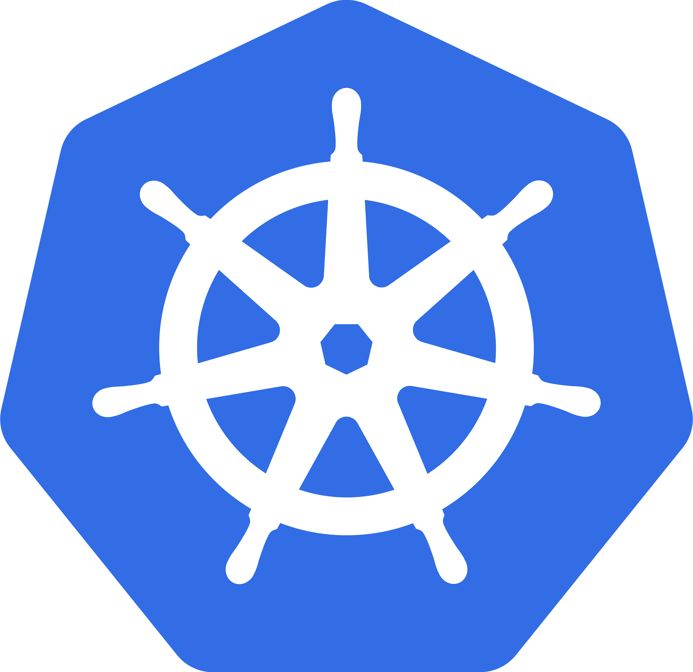

Leverage Kubernetes Operators & Helm Charts to manage deployments
Developer / OpenShift User
K8s API
Kubernetes Operator
Native Kubernetes Resources
Embed Ops knowledge
Custom Resource
Custom Kubernetes Controller
kind: ProductionReadyDatabase apiVersion: database.example.com/v1alpha1 metadata: name: my-important-database spec: connectionPoolSize: 300 readReplicas: 2 version: v4.0.1
Watch Events
Reconciliation
Deployments
StatefulSets
Autoscalers
Secrets
Config maps PersistentVolume
+ Custom Resource Definition
Helm Package and Basic Install
Operator Automated Day-2 Operations
Phase I
Phase II
Phase III
Phase IV
Phase V
Basic Install
Automated application provisioning and configuration management
Seamless Upgrades
Patch and minor version upgrades supported
Full Lifecycle
App lifecycle, storage lifecycle (backup, failure recovery)
Deep Insights
Metrics, alerts, log processing and workload analysis
Auto Pilot
Horizontal/vertical scaling, auto config tuning, abnormal detection, scheduling tuning
Notes:
https://docs.google.com/presentation/d/1c-H_UcyeACq314QsK1aWo8qFi_iuZLzIHTJ7xQ-ZcTQ/edit#slide=id.g61df18da44_0_0
https://docs.google.com/presentation/d/1SzOyaZ1PnWeqGJmwkm_F9tlatV5ubWAh19vlCZyFxMI/edit#slide=id.g547716335e_0_260

Slide 22
Platform Services

Slide 23









OpenShift Delivers a Complete Application Platform
Platform services
Service mesh ⠇Serverless Builds ⠇CI/CD pipelines
Log management Cost management
OpenShift Service Mesh with Istio to connect, secure and observe services
OpenShift GitOps with ArgoCD to enable declarative GitOps based continuous delivery
OpenShift Serverless with Knative to enable hybrid Serverless, FaaS & Event Driven Architectures
Application level observability for developers to build and manage their apps
OpenShift Builds with Shipwright to build images from code using S2I + other & integrate with Github Actions
Log management of infrastructure, application, and audit logs + forwarding capabilities
OpenShift Pipelines with Tekton to provide Kubernetes-Native CI/CD pipelines
Cost management visibility, mapping, and modeling across hybrid infrastructure in order to stay on budget
Kubernetes Cluster services
Kubernetes
Linux
Physical
Virtual
Private cloud
Public cloud
Edge
Notes:
Ultimately developers just want to build and deploy their apps quickly and address the things *they* care about
These additional application services will also need to be procured and integrated on top of your Kubernetes platform
OpenShift delivers a complete application platform that provides a wide array of services, from Red Hat and our ISV partners to meet developer needs
How do I build my application images? (OpenShift Builds lets you build on the platform using S2I, Buildpacks and Buildah or you can integrate w/ your existing build environment to create images and just deploy them to OpenShift)
Will this integrate with our CI? (OpenShift Pipelines provide Kubernetes-native CI/CD with Tektonand OpenShift also includes Jenkins CI service)
Can we build deployment pipelines to promote to prod? (OpenShift Pipelines provide Kubernetes-native CI/CD with Tekton)
Does this integrate with Git? (OpenShift GitOps enables Git driven deployment workflows plus OpenShift integrates with any Git environment and supports Github Actions)
Does this provide a service mesh? (OpenShift Service Mesh provides a fully supported Istio-based service mesh and includes components like Jaeger and Kiali for transaction tracing and debugging)
Does this integrate with my IDE? (OpenShift provides plugins for popular IDEs like VSCode, IntelliJ and Eclipse)
How do I debug my apps? (OpenShift provides integrated Developer Console, CLI & IDE plugins plus app monitoring & tracing to debug apps)
What programming languages/ frameworks does this support? (OpenShift includes supported builder images for popular programming languages/runtimes & you can bring your own)
What services are available to connect to my apps? (OpenShift includes supported database runtimes and access to a wide range of services via OpenShift Marketplace)
Can I use this to run event driven apps/functions? (OpenShift Serverless enables hybrid serverless capabilities to support event driven apps & functions)

Slide 24

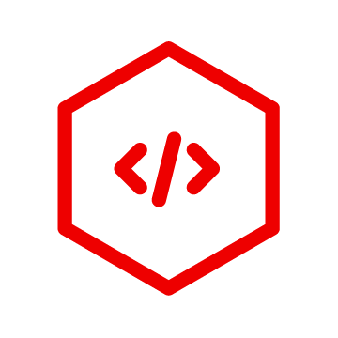





OpenShift Service Mesh with Istio to connect, secure and observe services
Connect, Secure, Control and Observe Services on OpenShift
Connect services securely with zero-trust network policies.
Automatically secure your services with managed authentication, authorization and encryption.
Control traffic to safely manage deployments, A/B testing, chaos engineering and more.
See what’s happening with out of the box distributed tracing, metrics and logging.
Manage OpenShift Service Mesh with the Kiali web console.
Services
Envoy
Envoy
Envoy
OpenShift Service Mesh
Istio
Kiali
Jaeger
OPENSHIFT
Red Hat Enterprise Linux CoreOS
Product briefing deck
Physical
Virtual
Private cloud
Public cloud
* Eventing is currently in Technology Preview
** Functions are currently a work in progress initiative
Notes:
https://docs.google.com/presentation/d/18XO-wSPgcU9SfmHF8rmuXrtOXsRfnt0p5fiHsWhADG0/edit#slide=id.ga4051c3f36_2_0

Slide 25



OpenShift Serverless with Knative to enable hybrid Serverless, FaaS & Event Driven Architectures
Event-driven serverless containers and functions
Deploy and run serverless containers
Use any programming language or runtime
Modernize existing applications to run serverless
Powered by a rich ecosystem of event sources
Manage serverless apps natively in Kubernetes
Based on open source project Knative
Run anywhere OpenShift runs
Applications/Functions
Events
F
OpenShift Serverless
SERVING
FUNCTIONS
EVENTING
OPENSHIFT
Red Hat Enterprise Linux CoreOS
Physical
Virtual
Private cloud
Public cloud
Notes:
https://docs.google.com/presentation/d/1ClEqyIYsm5xLo-uf5f-42v3iB3_WG131YrFif3fdsTY/edit#slide=id.g6b619a1e04_0_2548
So far we covered the serverless market. But we have baked serverless capabilities into the platform with OpenShift Serverless enabling almost any containerized application to run Serverless. That means you can choose any programming language of choice and enable auto-scaling behavior, scaling up to meet demand and down even to zero.
Beyond auto-scaling for HTTP requests, you can trigger those serverless containers from a variety of event sources and receive events such as Kafka messages, file upload to Storage, Timers for recurring jobs and 100+ event sources like Salesforce, Service Now, E-mail, etc… powered by Camel-K .
OpenShift Serverless is based on the open source project Knative, one of the fastest growing Serverless projects in the market. This ensures that you don't suffer with lock-in concerns and can still get the innovation from a growing open source community.
We are very happy to announce that OpenShift Serverless is now GA, which means you can take it to production and run anywhere OpenShift runs, delivering a hybrid serverless experience with portability and flexibility.

Slide 26

Build images on OpenShift and Kubernetes
Use Kubernetes build tools
Source-to-Image
Buildpacks
Buildah
Kaniko
...more
Create lean application images
Extend with your own build tools
Based on Shipwright open-source project
OpenShift Builds with Shipwright to build images from code using S2I + other & integrate with Github Actions
OpenShift Builds
Application code
Runtime image
Runtime image
Build tools image
Application image
Notes:
https://docs.google.com/presentation/d/1yz4nGK1hsEro6lczcwsPe8sJ3M9yONYlkzmxlnAAJuc/edit#slide=id.g9fb596f84b_0_828

Slide 27
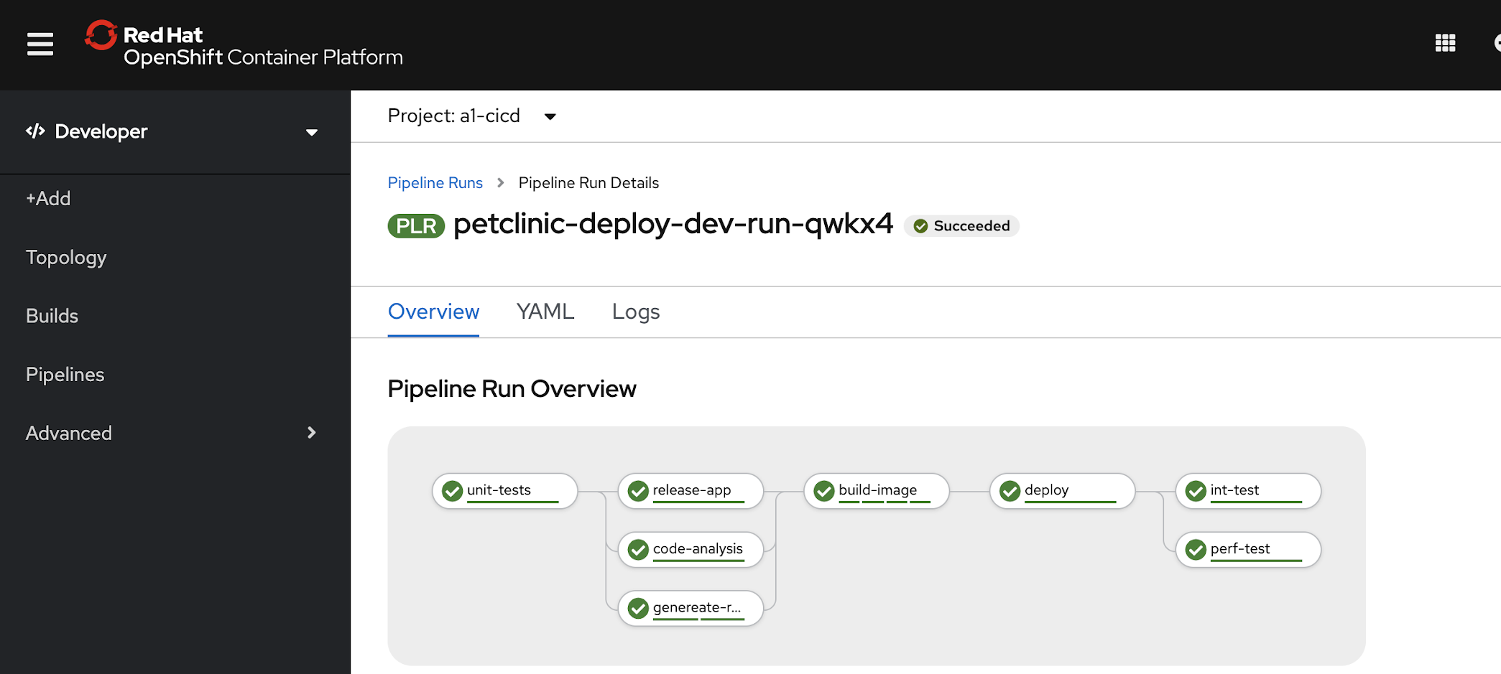
Tekton Concepts
OpenShift Pipelines with Tekton to provide Kubernetes-Native CI/CD pipelines
Pipeline
Based on Tekton Pipelines
Kubernetes-native declarative CI/CD
Pipelines run on-demand in isolated containers
No central server to maintain! No plugin conflicts!
Task library and integration with Tekton Hub
Secure pipelines aligned with Kubernetes RBAC
Visual and IDE-based pipeline authoring
Pipeline templates when importing apps
Automated install and upgrades via OperatorHub
CLI, Web, VS Code and IntelliJ plugins
Task
Task
step
Task
step
Task
step
step
step
step
step
step
Notes:
https://docs.google.com/presentation/d/1yz4nGK1hsEro6lczcwsPe8sJ3M9yONYlkzmxlnAAJuc/edit#slide=id.g9fb596f84b_0_836

Slide 28




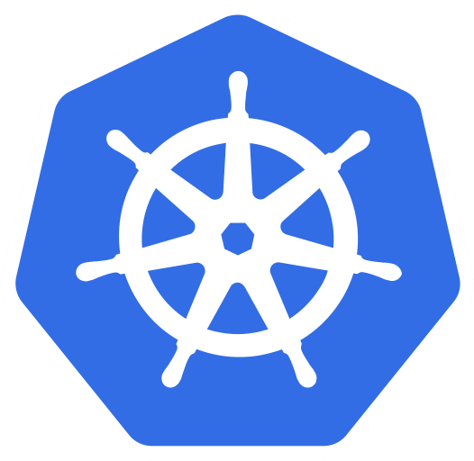

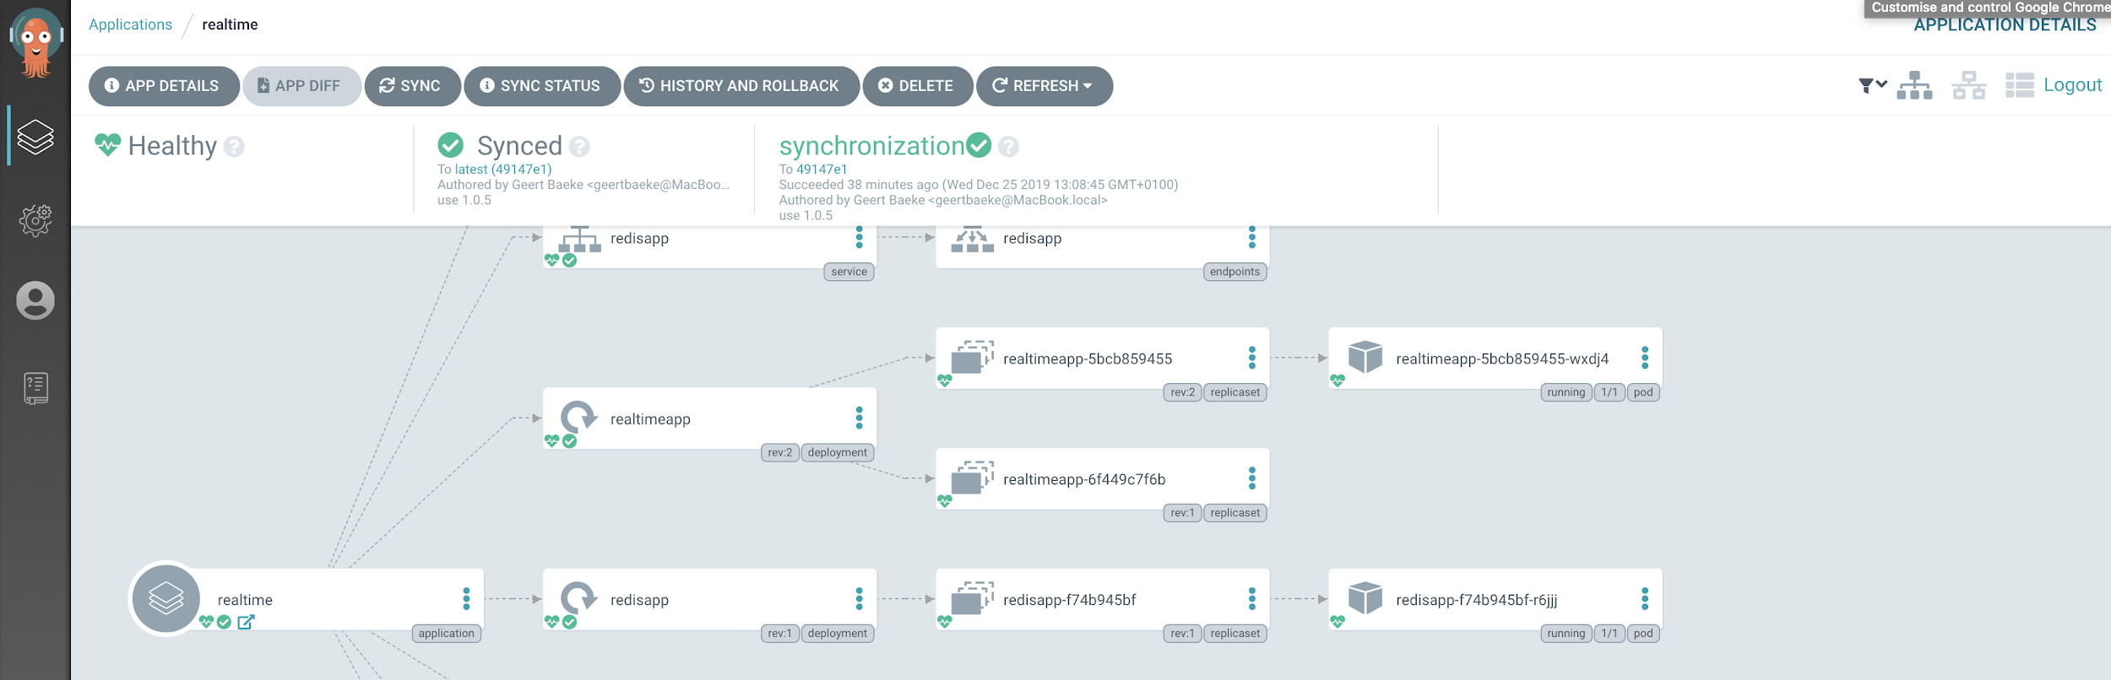
OpenShift GitOps with Argo CD to enable declarative GitOps based continuous delivery
OpenShift (on-premises)
Configurations versioned in Git
Automatically syncs configuration from Git
Drift detection, visualization and correction
Granular control over sync order
Rollback and rollforward to any Git commit
Manifest templating support (Helm, Kustomize, etc)
Visual insight into sync status
PR Merged
webhook
sync
OpenShift (public cloud)
poll
hooks
Kubernetes
Notes:
https://docs.google.com/presentation/d/1yz4nGK1hsEro6lczcwsPe8sJ3M9yONYlkzmxlnAAJuc/edit#slide=id.g9febc0b276_0_78
Argo CD is the core of OpenShift GitOps. With Argo CD the state of the cluster and application configurations are versioned and stored in Git. Argo CD can automatically sync your declared configuration from Git to one or many clusters. It can also detect drift and automatically correct errors and reconcile differences. It also gives you control over how you perform sync order for complex rollouts. Since Git is the center of your GitOps workflows, rollbacks and rollforward is easy with Argo CD. There is native built in templating support for common developer tool sets like Helm and Kustomize. Argo CD also gives you l insight into sync status and history for easy debugging and visualization of the state of your cluster or clusters.

Slide 29
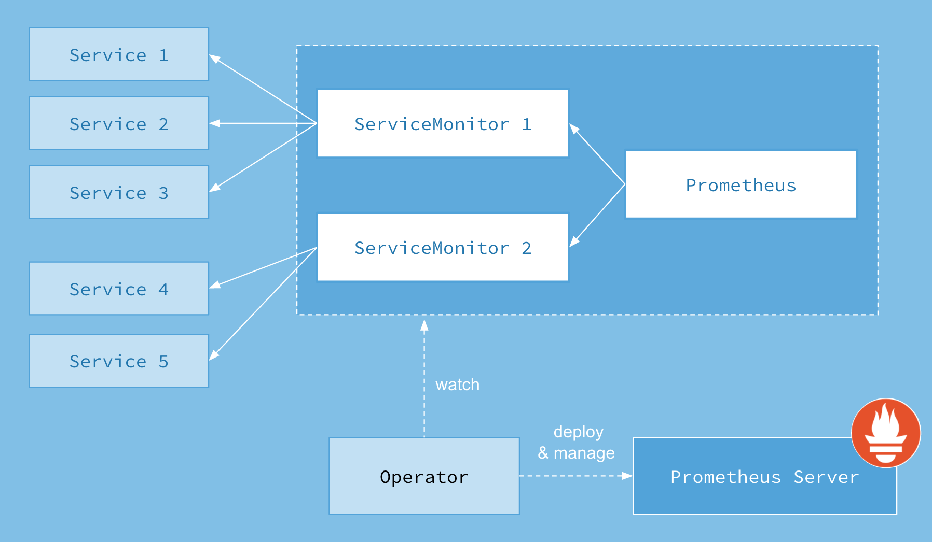
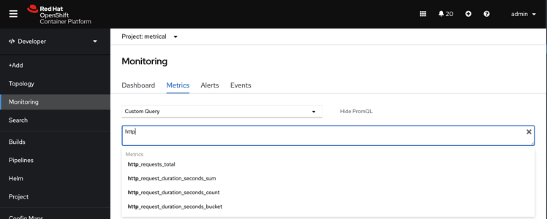
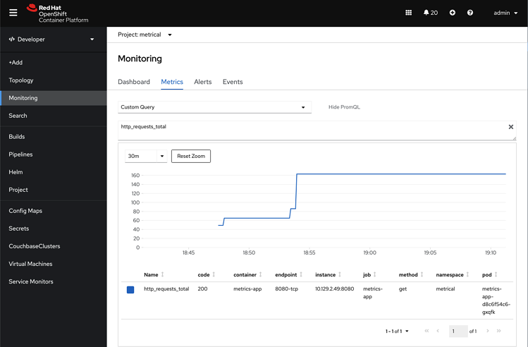
Application level observability for developers to build and manage their apps
Collect metrics from your own applications running in a user-defined namespace.
Define your own alerting rules based on your own metrics and any other metrics available in the same namespace (e.g. CPU and Memory).
Explore all metrics (your own or built-in) and alerting rules via the OpenShift Console in a multi-tenant fashion.
Notes:
https://docs.google.com/presentation/d/1jGZKju1Kyb6eaU6g_GLcZ3_AstkmedEvpSuTThvUJUk/edit#slide=id.g718e694e43_1_0
https://www.openshift.com/blog/monitoring-your-own-workloads-in-the-developer-console-in-openshift-container-platform-4.6

Slide 30




Log management
OpenShift Logging Managed Service
Fluentd
Fluentd
TLS
Node
Fluentd
Node
Aggregation, index & low retention storage
TLS
Analysis & Visualization
Node
Log forwarding to various supported systems.
An opinionated collector and normalizer of application, infrastructure and audit logs
Optional, low retention, managed centralized storage
Log collection
Customer Managed Service
Notes:
https://docs.google.com/presentation/d/1BJ8EqDay_k1qp3Lxzu9j9sTEs6OGMxLJQ5wdo-UcSos/edit#slide=id.p

Slide 31
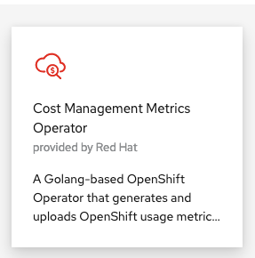
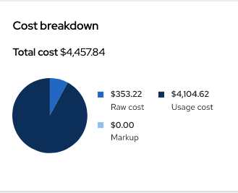
Cost Management
Certified Operator
Install both in parallel to upgrade
Improvements in performance
New big data processing for better UX
Integration to OpenShift Cluster Manager
Now you can see your cluster costs in OCM
New navigation
Cost management is now accessible from OCM
Google Cloud as a new source
Add your GCP sources to cost management
OCP on GCP still being developed
New view (cost explorer)
View your data grouped by different concepts, in time
Line items for the reports readily available
Child accounts in AWS
You no longer need to provide the parent account for cost management, if your account can provide CUR files
Refine what data is shared with cost management
 | Certified Operator | Koku metrics operator
Naming | Cost management metrics operator | Cost management metrics operator
Support | Supported by Red Hat | Upstream (community support)
Location | In Cluster Operator Hub | In Cluster Operator Hub
Availability | Today | Today
Notes:
https://docs.google.com/presentation/d/1Z4x0o7-FNj7yV_nHfZnV0AiH_eU0Lzu81_6VcA_Bzbo/edit#slide=id.g57c47e0ae0_0_0

Slide 32
Application Services

Slide 33
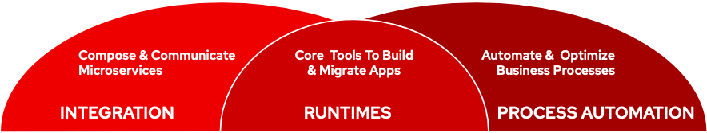
Develop and Connect Cloud Native Applications
Application services
Languages & runtimes
API management
Integration
Messaging
Process Automation
Create, run and maintain
traditional and cloud-native
apps for on-premise, cloud or
hybrid architectures
Red Hat APPLICATION SERVICES
Kubernetes Cluster services
VIRTUAL
PRIVATE CLOUD
PUBLIC CLOUD
Kubernetes
Linux
Physical
Virtual
Private cloud
Public cloud
Edge
Notes:
https://docs.google.com/presentation/d/14vbEh5fuDFlDDGDObm9lXBQyIzY-sJRU_Nf_144MQ0w/edit#slide=id.g9351370c89_7_1037

Slide 34
















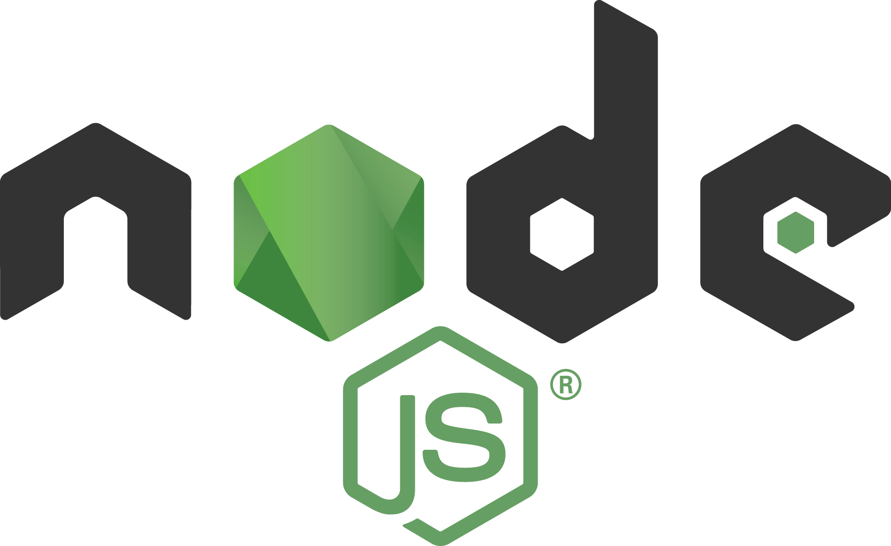





Red Hat Application Services
SSO
*
AMQ
AMQ
Notes:
Add links...

Slide 35
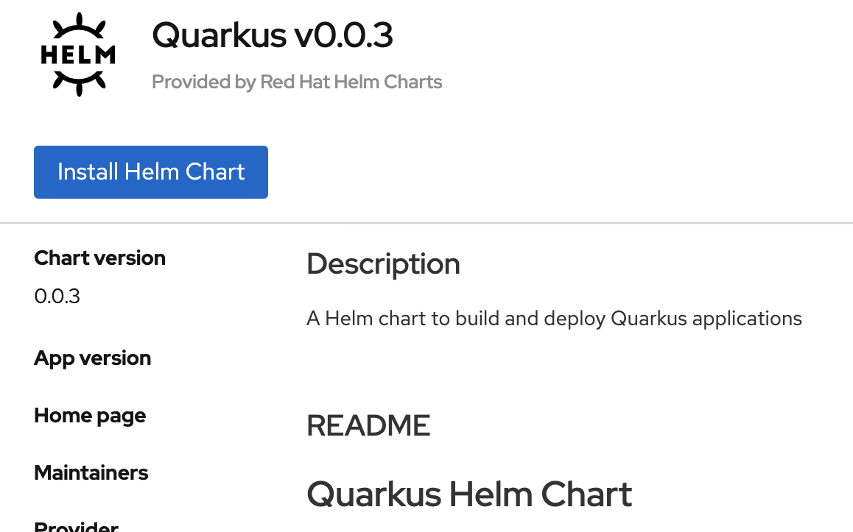
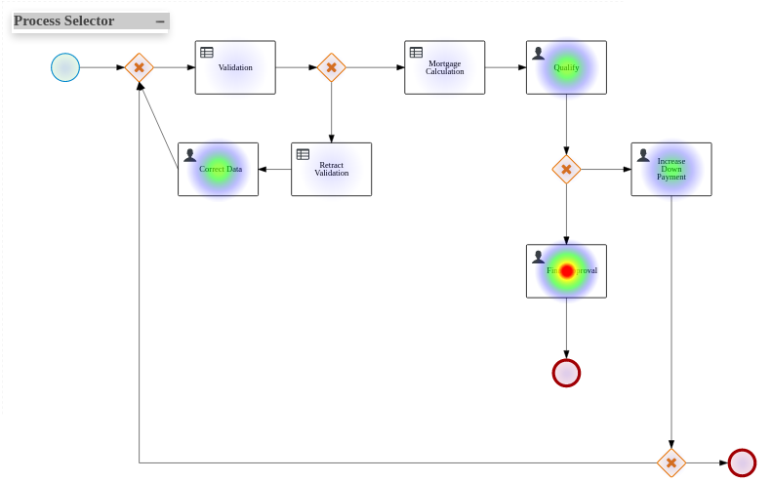
Red Hat Application Services
Red Hat Runtimes
Quarkus - Quick Starts, Example Helm Chart, Integration with Serverless Functions (DP)
EAP - Azure App Service (GA), Azure Marketplace, EAP XP 2.0 (Runnable JARs)
Spring Boot 2.3 - Support for UBI for Java 8 and 11, Security Starter, Dekorate Build Hooks (TP)
Red Hat Integration
APIs - OSD Add-On: Managed API Service (GA), 3scale Manageability Enhancements
Messaging - AMQ Broker/Online, Interconnect LTS, AMQ Interconnect 2.0 (DP)
Streaming - Kafka 2.7 support in AMQ Streams, Service Registry 2.0 (TP)
Red Hat Process Automation
PAM 7.10 - First release with Kogito technology, Kafka integration, React support
Dashboard Builder - Heat Map component
Events
APIs
EIPs
Data

Slide 36





Data services
Databases ⠇Cache Data ingest & prep
Data analytics ⠇AI/ML Data mgmt & resilience
Red Hat Data Services
Notes:
ODF - https://docs.google.com/presentation/d/1Ch5FUFkqx8j7shtJro_dR_bY7I3lkQc00i0PdhYnebk/edit#slide=id.gf5c3c27466_0_2957
Ceph - https://docs.google.com/presentation/d/1TcCRsRi6b0NVzHWpVgwkRsxJZoMzNgx96Zac9RmjFzg/edit#slide=id.g821c74ca09_0_19
ODS - https://docs.google.com/presentation/d/11m70qDPmFE_qi30noMl7eFvBRhrN91nyYuizHkqYx3s/edit#slide=id.ga66cd00dcb_0_0

Slide 37

WHAT'S NEXT IN OPENSHIFT
DEVELOPER
SERVICES

Slide 38




OpenShift Developer Console & CLI enhancements to improve dev experience
OpenShift IDE plugin integrations to meet the developer where they are
CodeReady Workspaces with Eclipse Che for cloud native development & collaboration
OpenShift developer sandbox and local cluster enhancements to improve access
Platform services
Application services
Data services
Developer services
Service mesh ⠇Serverless Builds ⠇CI/CD pipelines
Log management Cost management
Languages & runtimes
API management
Integration
Messaging
Process Automation
Databases ⠇Cache Data ingest & prep
Data analytics ⠇AI/ML Data mgmt & resilience
Developer CLI ⠇IDE
Plugins & extensions CodeReady Workspaces CodeReady Containers
Kubernetes Cluster services Install ⠇Over-the-air updates ⠇Networking ⠇Ingress ⠇Storage ⠇Monitoring ⠇Logging ⠇Registry ⠇Authorization
Containers ⠇VMs ⠇Operators ⠇Helm Charts
Kubernetes (orchestration)
Linux (container host OS)
Physical
Virtual
Private cloud
Public cloud
Edge

Slide 39
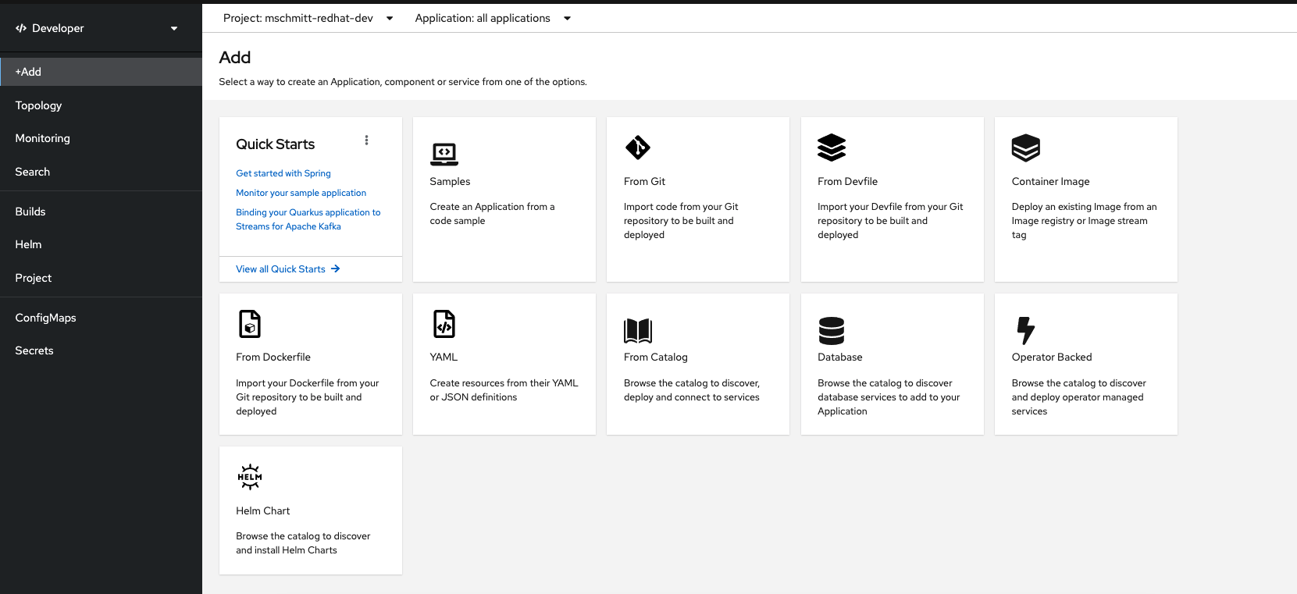
OpenShift Developer Console
Deploy code/resources easily from a flexible number of options
Notes:
https://docs.google.com/presentation/d/1cUw38VWFjs8_vlOSmJ6-HwzQVQ7NmAFizr3333PPaB4/edit#slide=id.gded5bb4f37_0_95

Slide 40
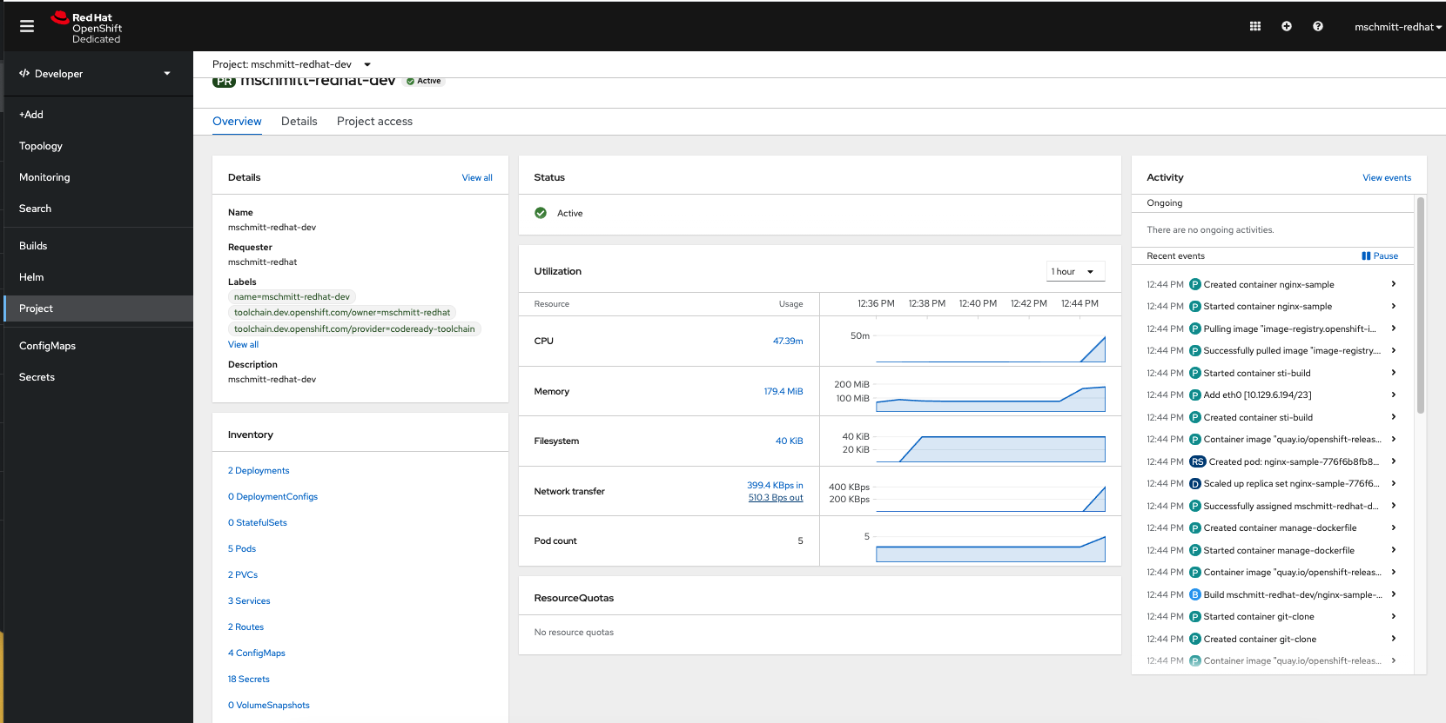
OpenShift Developer Console

Slide 41
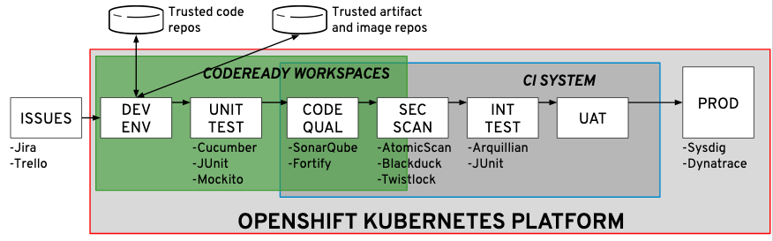
CodeReady Workspaces w/Eclipse Che
Notes:
https://docs.google.com/presentation/d/1ph2uVWdWVz-2oWf23o33X9wPirqZBO1sqY5U3b4KDVA/edit#slide=id.g6ef25e8c89_0_0

Slide 42






OpenShift IDE plugins and other tooling
OpenShift Connector
OpenShift/Kubernetes extension for IDEs
Enables rapid development and deployment of code
Provides local OpenShift cluster creation using Red Hat CodeReady Containers in VS Code extension
Easily view projects, applications and more
CodeReady Workspaces
Kubernetes-based IDE
Accelerates projects and onboarding; from 0 to coding in 2 minutes
Familiar VSCode-like experience in the browser, with plugin extensibility
Reproducible and consistent developer environments defined in a file in git
odo
Developer CLI for OpenShift & Kubernetes
Dependency Analytics
Shift Left Security
Easily start with project from runtime sample
Quickly iterate on code changes without full container rebuilds
Consistency on experience regardless of language
Find & remedy issues faster from within an editor
Scans for vulnerabilities, licenses & more
Powered by industry-leading vulnerability database - Snyk Intel
$ odo create nodejs --starter
Notes:
https://docs.google.com/presentation/d/1yp-yYHnffC3nm74gtHZ7s4pECcwvjRPs5slprIDZE0c/edit#slide=id.g6b17c292a3_0_5

Slide 43
OpenShift Platform Plus

Slide 44



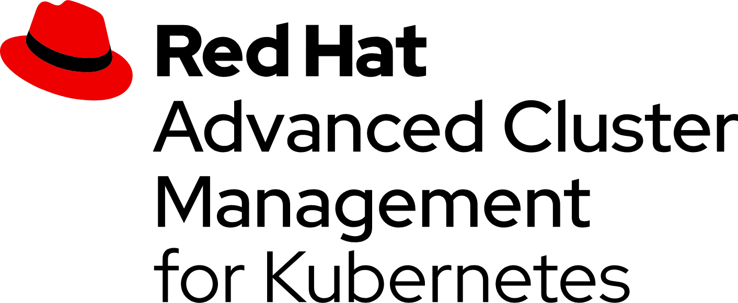
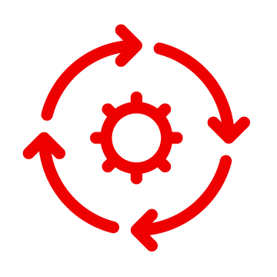


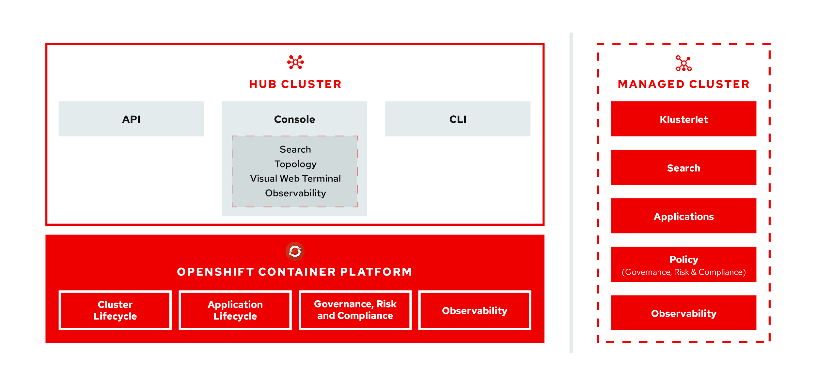
Multicluster Management
Observability ⠇Discovery ⠇Policy ⠇Compliance ⠇Configuration ⠇Workloads
Installation and Conf Mgmt
App Lifecycle
Metrics, Alerts, Logs, Monitoring
Platform Upgrades
Dependency Tracking
Advanced Healing
Hub architecture and components
Red Hat Advanced Cluster Management uses the multicluster-hub operator and runs in the open-cluster-management namespace
Managed cluster architecture and components
Red Hat Advanced Cluster Management managed clusters use the multicluster-endpoint operator which runs in the open-cluster-management namespace
Notes:
https://docs.google.com/presentation/d/1v2SLp-3LzPTFUI4xJx0PTdc6iylMVM8jFVYZEI5Ubz4/edit#slide=id.g33d3279d41_0_37

Slide 45
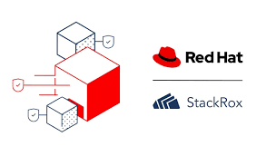
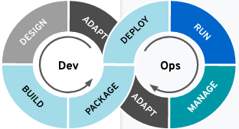
















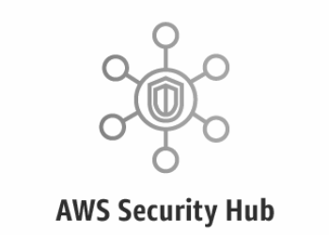
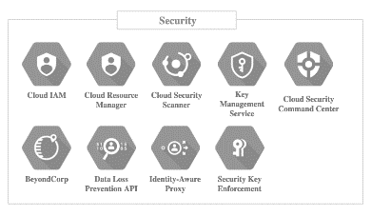


Red Hat Advanced Cluster Security
Cluster Security
Declarative security ⠇ Container vulnerability management ⠇ Network segmentation ⠇ Threat detection & response
Red Hat Advanced Cluster Security for Kubernetes
Build
Secure supply chain
Deploy
Secure infrastructure
Run
Secure workloads
Policy engine
API
Image scanning
Registries
CI/CD tools
DevOps notification
SIEM
AWS Security Hub
Physical
Virtual
Private cloud
Public cloud
Edge
Notes:
https://docs.google.com/presentation/d/1g3BI76iW0nGCNPmHZ5ouhPnAfDm2RmETWwcCdv2mJB4/edit#slide=id.g7b13a52c4c_1_1635

Slide 46

Red Hat Quay
Red Hat Quay Key Features
REGISTRY
SECURITY
Massive Scale Testing Quay.io
Real Time Garbage Collection
Automated Squashing
SCALABILITY
Vulnerability Scanning
Logging & Auditing
Notifications & Alerting
High Availability
Full Standards / Spec Support
Long-Term Protocol Support
OCI compatibility
Enterprise Grade Support
Regular Updates
Seamless Git Integration
Build Workers
Webhooks
BUILD AUTOMATION
CONTENT
DISTRIBUTION
Geo-Replication
Repository Mirroring
Air-Gapped Environments
Extensible API
Webhooks, OAuth
Robot Accounts
INTEGRATION
ACCESS
CONTROL
Authentication Providers
Fine-Grained RBAC
Organizations & Teams
Notes:
https://docs.google.com/presentation/d/16fLRqiUeHiKsrhIgjKB_E2qkDB-9SWBfjtD1_sgZNNs/edit#slide=id.g6c8515c114_0_4069

Slide 47



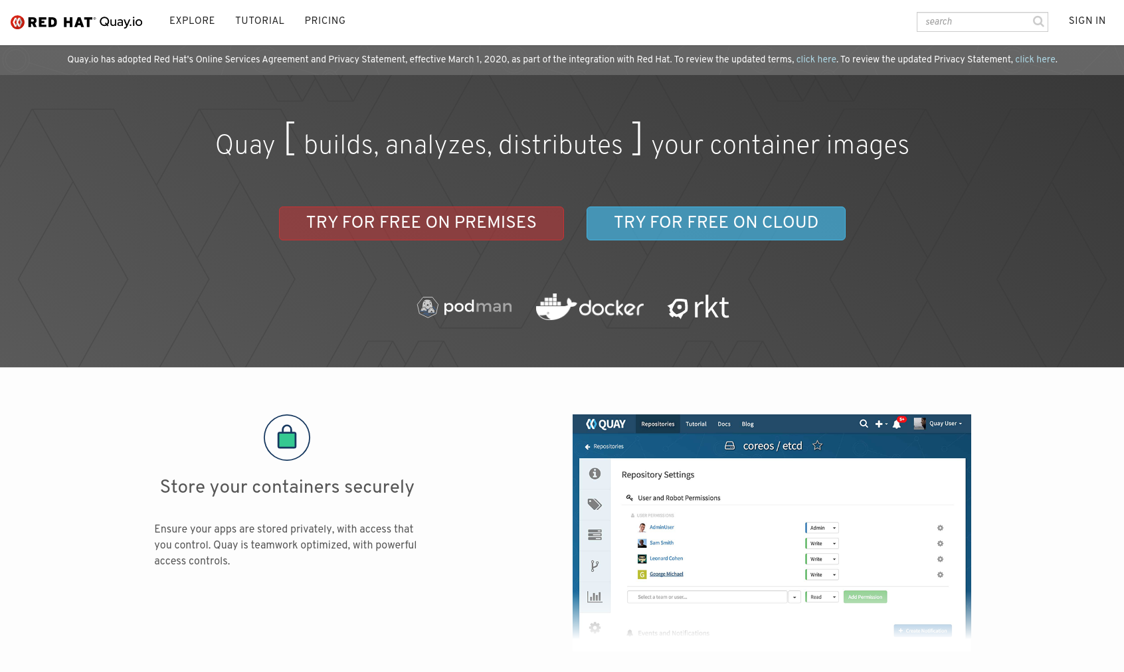
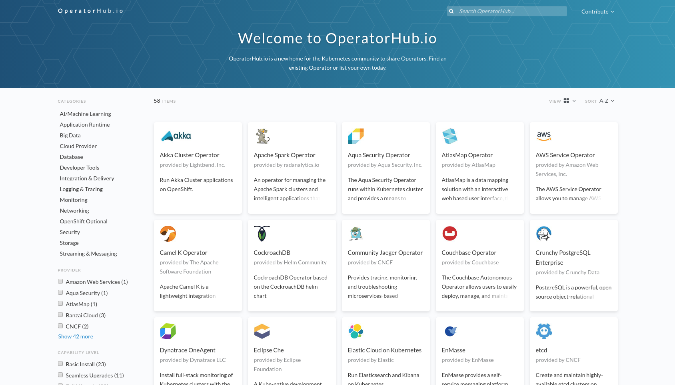
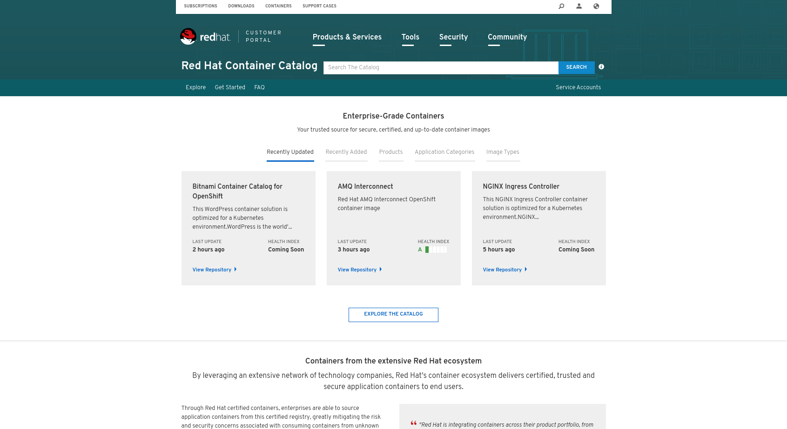



Global Registry
Red Hat Quay
Image management ⠇Security scanning ⠇Geo-replication Mirroring ⠇Image builds
Enterprise grade registry...
Content Ingress
UI API
CLI
Other Clients
Container Security Operator
Quay Bridge Operator
CVE Metadata
quay.io
Load Balancer
Quay Container
Clair Container
Mirroring Worker
Quay Builders
operatorhub.io
Quay Operator
Red Hat Container Catalog
Storage
Database
Cache
Quay Backend Services
Standalone Container Host(s)
Runtime or Orchestration
Suppliers
Any Infrastructure
Community
Laptop
Datacenter
OpenStack
Amazon Web Services
Microsoft Azure
Google Cloud
Custom
Content
Notes:
https://docs.google.com/presentation/d/16fLRqiUeHiKsrhIgjKB_E2qkDB-9SWBfjtD1_sgZNNs/edit#slide=id.g6c8515c114_0_4069

Slide 48
Thank you
Red Hat is the world’s leading provider of enterprise open source software solutions. Award-winning support, training, and consulting services make
Red Hat a trusted adviser to the Fortune 500.

